Slide 1
Microprogrammed Control
Unit 4

Slide 2
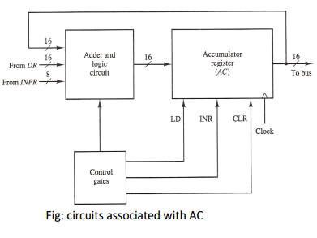
Design of Accumulator logic

Slide 3
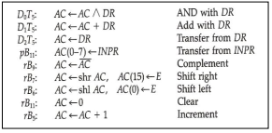
Change AC

Slide 4
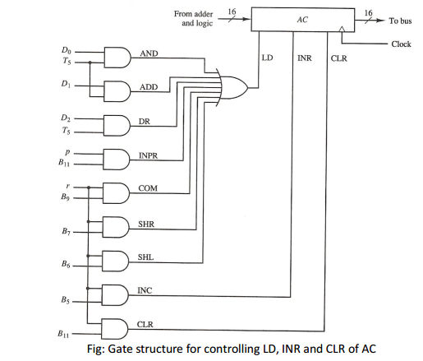
Gate Structure For Controlling AC

Slide 5
Control unit
Initiate sequence of microoperations
Number of microoperations are finite

Slide 6
Control Unit
Control Unit is implemented In 2 ways:-
Hardwired Control – fixed instructions, fixed logic block, encoder, decoder.
-CU is made up of sequential and combinational circuits to generate the control signals. – If logic is changed we need to change the whole circuitry – Expensive – high speed operations.
-complex
-no flexibility of adding instructions
-Intel 8085,motorola 6802,RISC.

Slide 7
Micro programmed Control – A control memory on the processor contains micro-programs that activate the necessary control signals. – If logic is changed we only need to change the micro-program. – Cheap – Slow
-Intel 8080,Motorola 68000, CISC.

Slide 8
Hardwired Control

Slide 9
Introduction
Control logic is implemented with gates, flip flops, decoder and other digital circuits.
If logic is changed we need to change the whole circuitry
Expensive
Fast

Slide 10
Timing And Control
Generated by 4-bit sequence counter and 4x16 decoder. ▪ The SC can be incremented or cleared. ▪ Example: T0, T1, T2, T3, T4, T0, T1 . . .

Slide 11
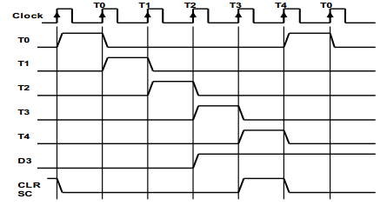
Timing Signal

Slide 12
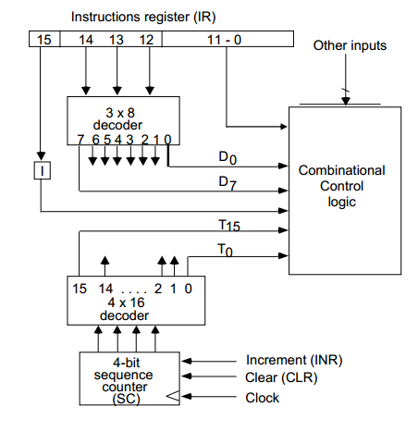
Control Unit Of Basic Computer

Slide 13
Control Memory

Slide 14
Control Word
Control function specifies a microoperation is a binary variable.
When it is in one binary state microoperation is executed.(other doesn’t change)
Active state can be 1 or 0 depending on application.
Control variables at any given time can be represented by string of 0’s and 1’s called control word.

Slide 15
Control Memory
Contains 2 memory
Main Memory
Used to store program
Content can be altered
Control Memory
Located in control unit
Contains fixed microprogrammed that can’t be altered by occasional user.
Consists of microinstructions
Microinstructions specify various register microoperations.

Slide 16
Microinstruction
Each word in control memory is microinstruction.
Microinstruction specifies one or more microoperations.
Sequence of microinstructions are Microprogram.
Advance technology-Dynamic programming
Microprogram loaded from auxiliary device.
Writable control memory.
But control memory are mostly used for reading.

Slide 17
Micro programmed Control

Slide 18
Control word
It is a string of control variables (0’s and 1’s) occupying a word in control memory.
Microprogram
Program stored in control memory that generates all the control signals required to execute the instruction set correctly
Consists of microinstructions

Slide 19
Microinstruction ✓ Contains a control word and a sequencing word ✓ Control Word – contains one or more microoperations ✓ Sequencing Word - Contains information needed to decide the next microinstruction address .

Slide 20
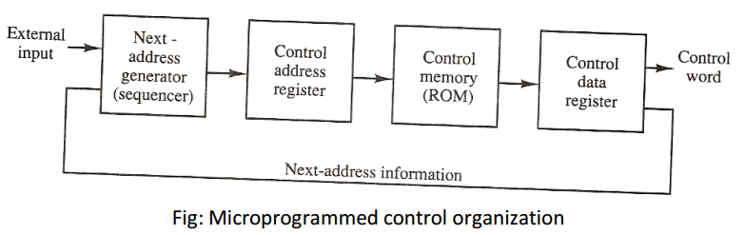
Micro Programmed Control Organization

Slide 21
Microprogrammed control Organization
Control memory is ROM, within which all control information is permanently stored.
Control memory Address Register specifies the address of microinstruction.
Control Data Register holds the microinstruction read from memory.

Slide 22
Microprogrammed control Organization
Microinstructions contains control word that specifies one or more microoperations.
After execution the location of next microinstruction must be determine.
Address can be in sequence or out of sequence.
So, some bits of present microinstruction are used to determine the next address of microinstruction.
Next address is calculated in next address generator.
Also know as sequencer.(Determine next address in sequence)

Slide 23
Address Sequencing (Introduction)
Microinstructions are stored in control memory in groups.
Called routine.
Every computer instruction has its own microprogram routine in control memory, which generate sets of microoperations to execute that instruction.
Hardware that control address sequencing of control memory must be capable of sequencing microinstructions within routine or may able to branch from one routine to other.

Slide 24
Steps for execution of single computer instruction
Control address register is loaded with initial address when computer is on- may be fetch routine.
Fetch routine is sequenced by incrementing CAR.
At END of routine instruction is in IR.

Slide 25
Calculating Effective Address of operand.
Can be reached through branch microinstruction.
At END operand address is available in memory Address Register.

Slide 26
Execute Instruction
Opcode determine which routine should be run for execution of particular operation.
Each instruction has its own microprogram routine.
Mapping process
Process of transformation from opcode bit to an address in control memory where routine is located.

Slide 27
Address sequencing capabilities required in control memory
Incrementing of Control Address register.
Unconditional branch or conditional branch depending on status bit.
A mapping process from bit of instruction to control memory address.
A facility of subroutine call and return.

Slide 28
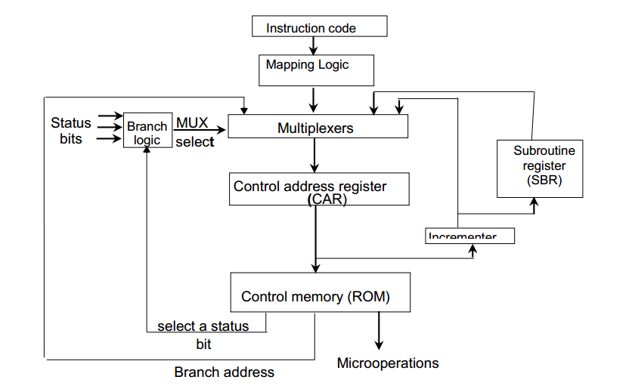
Block Diagram of Address Sequencer

Slide 29
Conditional Branching
If Condition is true, set the appropriate field of status register to 1. Conditions are tested for
O (overflow),
N (negative),
Z (zero) and C(carry)
Then test the value of that field if the value is 1 take branch address from the next address field of the current microinstruction Otherwise simple increment the address.

Slide 30
Unconditional branching
Fix the value of one status bit at the input of the multiplexer to 1. So that always branching is done.

Slide 31
Subroutine
Subroutine are program that are used by other routine to accomplished a particular task.
Subroutine can be called at any point in main program.
Some subroutine are frequently used in many routine.
E.g calculation of EA is common to all memory reference instruction.

Slide 32
When subroutine is called the incremented address is save in Subroutine register.
Register are arranged as stack- used in LIFO manner

Slide 33
Microprogram
After Microprogrammed Control unit is established
Designer generate microcode for control memory(Microprogramming)

Slide 34
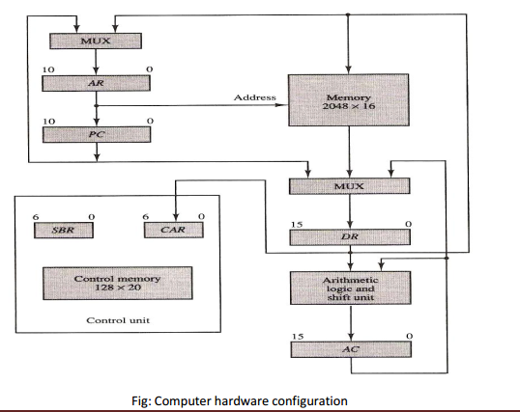
Computer Configuration

Slide 35
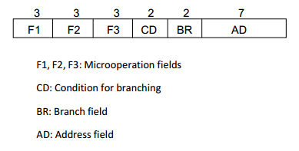
Microinstructions

Slide 36
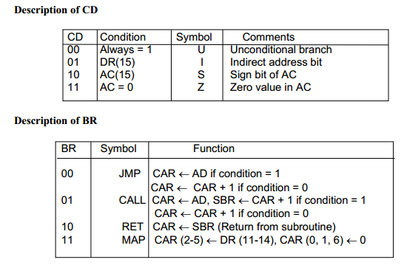

Slide 37
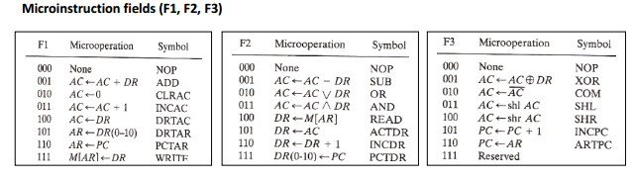

Slide 38
Symbolic Microinstruction
Symbols like ADD,CLRAC,READ,COM etc are used to specify microinstructions.
Assembler is used to translate symbolic microinstruction to its binary equivalent.
Contains five fields:-
Label:-This field may be empty or it may specify a symbolic address. A label is terminated with colon(:).
Microoperations field:- contains one, two or three symbols separated by commas.
CD:- one of U, I,S,Z.
BR- can contains 4 symbols. JMP,CALL,RET,MAP.

Slide 39
AD-With symbolic address
With Symbol NEXT to designate the next address in sequence.
When BR field contains RET or MAP Symbol, the AD field is left empty and is converted to 7 zeroes by assemblers.
ORG- origin address

Slide 40
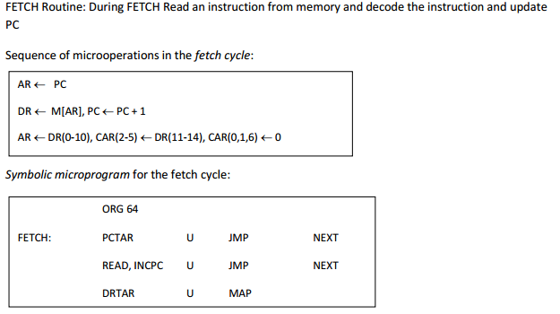
FETCH ROUTINE Example

Slide 41
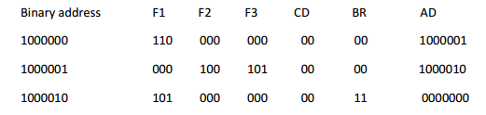
Binary Microprogram
Program not Stored in memory in Symbolic form.
Translated by assembler.

Slide 42
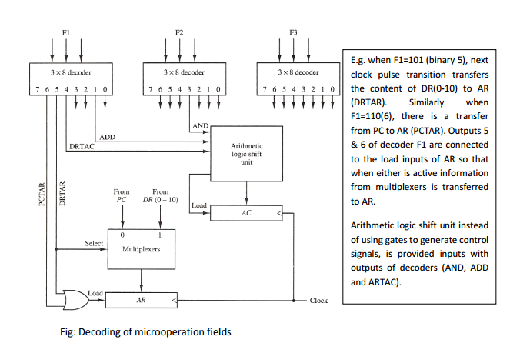
Design of Control Unit

Slide 43
Microprogram Sequencer
Basic component of microprogrammed are
Control memory and next address generator
Address selection part is microprogram sequencer.
It load CAR with address of microinstruction to fetch and execute next microprogram.
Control unit doesn’t contain one register but stack of SBR.

Slide 44
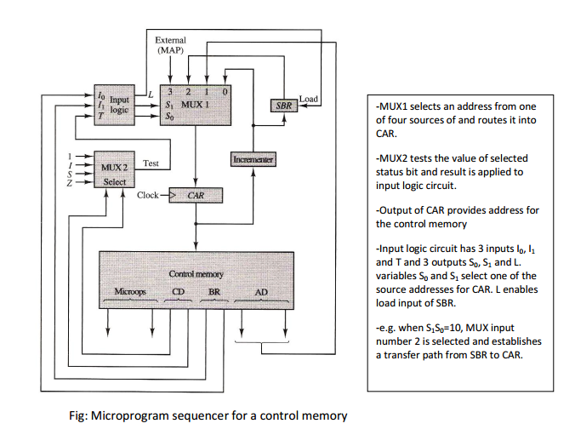
Microprogram Sequencer

Slide 45
